Slide 1
Delirium in 30
Recognising delirium
and caring for the person
Alasdair MacLullich
University of Edinburgh
Delirium Academy
For adult health and care staff and students
01
Notes:
A foundation for adult health and care staff and students. Use in general wards, emergency departments and care homes, with each person working within their role. This deck supports a 30-minute session. Allow about 23 minutes for teaching and 7 minutes for questions or the online assessment. The 30-minute course title is a planned duration. Intensive care, the immediate recovery room, children, alcohol or drug withdrawal, intoxication and end-of-life care require additional specialist teaching. Original Academy teaching by Professor Alasdair MacLullich. Slides adapted from his supplied 2026 talks and the current course. Slide design and language revision: 26 September 2026. This date is not a new clinical-review date. Original Academy text is CC BY 4.0. The 4AT and third-party images have separate terms. Photographs illustrate teaching and do not identify the people shown as having delirium.
Sources
https://deliriumacademy.com/introduction-to-delirium/

Slide 2
Mrs Morgan is different today
Example case
Usually chats and eats independently
Now sleepy, slow to answer and eating little
Her daughter says this began yesterday
What has changed, and what should happen now?
02
Notes:
Example case from Part 1. Mrs Morgan, 84, has dementia and was admitted after a fall. She normally chats, eats independently and walks with a frame. On day two she is less talkative, sleepy at times, slow to respond, eating little and needing more help to stand. Her daughter dates the change to yesterday. At times she seems more like herself. Ask learners what is new and what needs reporting. Answer: the acute change in several usual abilities needs prompt assessment for possible delirium. Dementia does not explain the new deterioration. The photograph is illustrative, not Mrs Morgan.
Sources
https://deliriumacademy.com/introduction-to-delirium/

Slide 3
03
Notes:
Delirium develops over hours or days, usually during illness, after an operation, or because of medicines or another physical problem. Difficulty paying attention and thinking clearly are central. Alertness, behaviour and perception may also change. The symptoms can vary during the day. Not everyone has all the features in this illustration. Hallucinations and agitation are not required. The illustration is reproduced from the current Academy course.
Sources
https://deliriumacademy.com/introduction-to-delirium/

Slide 4
Drowsy or withdrawn
Hypoactive delirium
Less speech
Slower responses
Less movement
Less eating and drinking
Often missed
A new change needs assessment even when the person is settled.
04
Notes:
Hypoactive delirium may include less speech, slow responses, poor attention, reduced movement and reduced eating or drinking. It is common in older inpatients and often missed. Describe the actual change and seek assessment. Severe reduction in responsiveness needs emergency assessment. The photograph illustrates reduced activity but does not establish delirium. Sources: current course Part 2, Morandi and colleagues 2017 and Inouye and colleagues 2001, linked from that section.
Sources
https://deliriumacademy.com/introduction-to-delirium/

Slide 5
Restless, frightened or agitated
Hyperactive delirium
Unable to settle
Pulling at bedding
Trying to leave
Some people have both patterns at different times
Ask about fear and discomfort in every presentation.
05
Notes:
Hyperactive delirium may include restlessness, pulling at bedding or trying to leave. A person may have hypoactive and hyperactive features at different times. Some people have hallucinations or frightening false beliefs. Distress also occurs in people who are still and say little. Assess how the person feels rather than inferring distress only from movement or noise. The photograph is illustrative.
Sources
https://deliriumacademy.com/introduction-to-delirium/

Slide 6
Delirium and dementia
 | Delirium | Dementia
Usual onset | Hours or days | Usually months or years
Within a day | Often fluctuates | Usually more stable*
New deterioration | Needs prompt assessment | Look for delirium or another acute problem
Delirium and dementia often occur together
*Dementia with Lewy bodies can also fluctuate. Compare with the person’s usual state.
06
Notes:
The comparison describes usual patterns. Dementia develops over months or years, while delirium is an acute change. Attention and alertness depend on the type and stage of dementia. Dementia with Lewy bodies can fluctuate. Compare with the person’s usual state, using the person, informants and records. Delirium and dementia often occur together. When distinction is difficult, assess and manage possible delirium promptly. A more settled hour does not exclude delirium.
Sources
https://deliriumacademy.com/introduction-to-delirium/

Slide 7

Delirium is common
1 in 4
adult medical inpatients
At some point during admission
Gibb and colleagues, Age and Ageing, 2020
07
Notes:
About one in four adult medical inpatients has delirium at some point during admission. Gibb et al. 2020 reported pooled prevalence of 23%, with 95% CI 19–26%. This is not a figure for every hospital setting, all ages, or every postoperative population. Older age, frailty, dementia and previous delirium increase risk. The emergency-department photograph comes from the supplied London medical grand-round deck, slide 34.
Sources
https://deliriumacademy.com/introduction-to-delirium/
https://doi.org/10.1093/ageing/afaa040
Supplied London medical grand-round presentation, slide 34

Slide 8
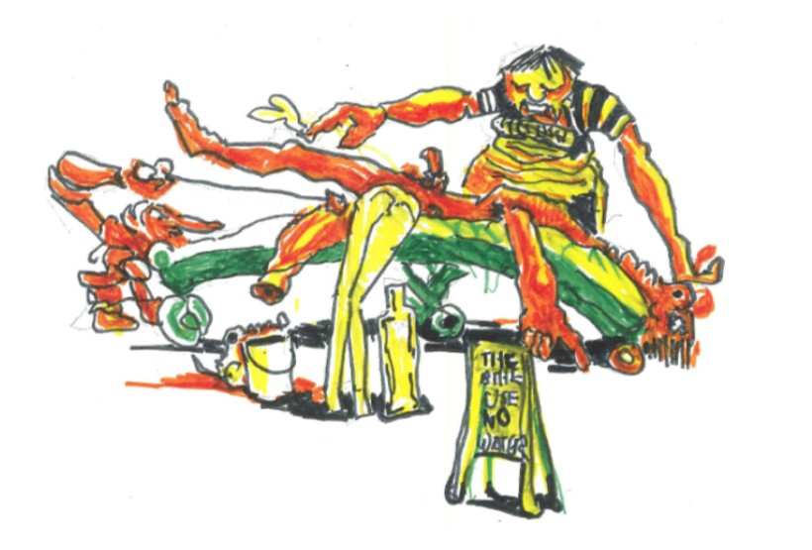
Delirium can have lasting consequences
Severe distress
Longer hospital stay
Loss of independence
Higher risks of death and later cognitive problems
These are increased risks. Individual recovery varies.
08
Notes:
Delirium is associated with longer hospital stays, increased mortality, loss of independence and later cognitive problems. People and families may experience severe distress. These are risks, not inevitable outcomes for each person. Do not turn an association into a causal estimate or predict an individual outcome from these statements. The illustration was supplied in the London medical grand-round deck, slide 63. Discuss how frightening experiences can continue to affect a person after the episode.
Sources
https://deliriumacademy.com/introduction-to-delirium/
Supplied London medical grand-round presentation, slides 7 and 63
https://doi.org/10.1001/jama.2010.1013

Slide 9
Ask someone who knows the person
What are they usually like?
What has changed?
When did it begin?
Has it varied?
Ask the person, family, carers and familiar staff. Check records.
09
Notes:
Baseline means the person’s usual abilities and behaviour before the change. Ask the person where possible. Family, carers, familiar staff and records can help. Ask how they usually think, converse and manage daily activities. Establish when the change began and whether it has varied. In the course, Mr Dawson describes his wife’s new suspiciousness and difficulty following conversation after surgery. Record both the history and who supplied it.
Sources
https://deliriumacademy.com/introduction-to-delirium/

Slide 10
When emergency help is needed
Very difficult to wake
Severe breathing problems
New weakness or speech difficulty
New change after a fall or head injury
Rapid deterioration
Use the emergency response. Do not delay urgent care to finish a delirium test.
10
Notes:
Use the local emergency response for a person who is very difficult to wake, has severe breathing problems, new weakness on one side or difficulty speaking, a new mental change after a fall or head injury, or rapid deterioration. Urgent assessment and treatment take priority. Do not delay emergency care to finish the 4AT. Trained staff follow their emergency assessment procedure, including blood glucose and physiological observations. All staff can call for help within local arrangements. In a care home use the urgent medical route rather than waiting for a routine visit.
Sources
https://deliriumacademy.com/introduction-to-delirium/

Slide 11
The 4AT
Item | Assessment | Scores
1. Alertness | Observe the person | 0 or 4
2. AMT4 | Age, date of birth, place, year | 0, 1 or 2
3. Attention | Months backwards from December | 0, 1 or 2
4. Acute change or fluctuating course | History and current evidence | 0 or 4
An assessment for possible delirium and cognitive impairment. Confirm the diagnosis clinically.
11
Notes:
The four items contribute to a total from 0 to 12. The AMT4 asks age, date of birth, place and current year. The attention task is Months Backwards from December. Item 4 concerns significant acute change or fluctuation arising within the last two weeks and still evident in the last 24 hours. Use the full official form and instructions. The table is an overview, not a replacement scoring instrument. The final diagnosis requires clinical assessment. Use local arrangements where another tool is used. NICE recommends CAM-ICU or ICDSC in critical care and the immediate postoperative recovery room.
Sources
https://deliriumacademy.com/introduction-to-delirium/
https://www.the4at.com/userguide
https://www.nice.org.uk/guidance/cg103/chapter/Recommendations

Slide 12
Months backwards
“Please tell me the months of the year in backwards order, starting at December.”
Response | Score
7 or more months correct | 0
Starts but fewer than 7 / refuses to start | 1
Untestable because unwell, drowsy or inattentive | 2
Use all four items and the official scoring instructions.
12
Notes:
Use the exact instruction from the official 4AT. One prompt of “what is the month before December?” is permitted to help initial understanding. Seven or more months correct, reaching June without error, scores 0. Starting but achieving fewer than seven, or refusing to start, scores 1. Unable to start because unwell, drowsy or inattentive scores 2. Refusal and inability due to illness are different categories. Account for hearing, language and communication difficulties when administering and interpreting the task. This is one item of the 4AT, not a standalone diagnostic test.
Sources
https://www.the4at.com/userguide
https://deliriumacademy.com/introduction-to-delirium/

Slide 13
A worked 4AT example
Mrs Dawson after surgery | Score
Alert | 0
Two AMT4 errors | 2
Months backwards: stops at August | 1
Clear change over two days | 4
7
Likely delirium
Example case. Clinical assessment and care follow the positive result.
13
Notes:
Example case: Mrs Dawson after her operation, from course Part 3. She is alert. She gives her age and place correctly but gets date of birth and year wrong. She starts Months Backwards and reaches August before stopping. Her husband describes a clear mental change over the past two days. Ask learners to calculate each item before revealing or explaining the total. 0 + 2 + 1 + 4 = 7. A positive 4AT should prompt clinical diagnostic assessment and investigation of causes. Do not treat the score as a prescription.
Sources
https://deliriumacademy.com/introduction-to-delirium/
https://www.the4at.com/userguide

Slide 14
Interpreting the total
4AT score | Interpretation
0 | Delirium and moderate-to-severe cognitive impairment unlikely. Neither is excluded.
1–3 | Possible cognitive impairment
4–12 | Likely delirium, with or without cognitive impairment
The final diagnosis requires clinical assessment
14
Notes:
0 suggests no delirium and no moderate-to-severe cognitive impairment, but neither is definitively excluded. 1–3 suggests possible cognitive impairment. 4–12 suggests likely delirium with or without cognitive impairment. Interpret every score with history and clinical findings. Severe dementia can produce positive cognitive-item scores, reducing specificity. A new concern can require further assessment even after a score of 0. Significant acute change within two weeks and evident in the previous 24 hours scores 4 on Item 4.
Sources
https://www.the4at.com/userguide
https://deliriumacademy.com/introduction-to-delirium/

Slide 15
A score of 0, then new information
A relative now reports a marked change
that began yesterday and is still present
0
What should happen next?
New history can change the score and the clinical assessment
Discussion. The teaching notes explain the scoring and response.
15
Notes:
Discussion based on the course assessment. A relative reports marked mental change beginning yesterday and still present today, after a score of 0 has been recorded. Ask what should happen. Answer: review the history and clinical findings, score Item 4 as 4 if that history is established, and update the total to at least 4. Arrange clinical assessment. Also explain that when illness, drowsiness or severe inattention prevents the cognitive tasks, the official 4AT provides an untestable score of 2 for each. Do not label the entire 4AT “unable to assess”. Use communication support and interpret in context.
Sources
https://deliriumacademy.com/introduction-to-delirium/
https://www.the4at.com/userguide

Slide 16
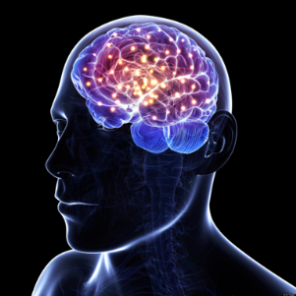
Look for several possible causes
Acute illness
Pain or injury
Low oxygen or glucose
Dehydration
Medicines or withdrawal
Bladder or bowel problems
Several causes may occur together. A fall or head injury needs particular attention.
16
Notes:
Delirium occurs when acute illness, injury, surgery, medicines or other physical problems disturb brain function. More than one cause may be present. Check infection, hypoxia, low blood glucose, head injury after a fall, pain, dehydration, constipation, urinary retention and medicine effects. Obtain a medication and alcohol history. Newly started or increased opioids, anticholinergic medicines such as oxybutynin or amitriptyline, benzodiazepines and sleeping tablets, and sudden withdrawal of alcohol or benzodiazepines may contribute. Withdrawal management needs its own pathway. Do not assume confusion alone establishes urinary infection. A positive dipstick alone in an older person does not establish it either. The brain illustration comes from medical grand-round slide 17.
Sources
https://deliriumacademy.com/introduction-to-delirium/
Supplied London medical grand-round presentation, slide 17

Slide 17

Mrs Morgan needs assessment and care
Fever and new low oxygen
Urgent medical assessment
Review medicines and the recent fall
Care, explanation and hearing aids
Example case. Treatment and everyday care proceed together.
17
Notes:
Return to the course case. Her nurse finds fever and a new low oxygen level and seeks urgent medical review. The clinician investigates and treats the causes, considering the recent fall and possible head injury as well as infection and hypoxia. The pharmacist reviews medicines, therapy staff assess movement and function, and her daughter supplies the history and brings her hearing aids. The source gives fever and low oxygen, not a confirmed infection or a completed investigation. Preserve that distinction. Everyone can notice, report and offer appropriate support. Investigations and treatment decisions depend on professional role and competence.
Sources
https://deliriumacademy.com/introduction-to-delirium/

Slide 18
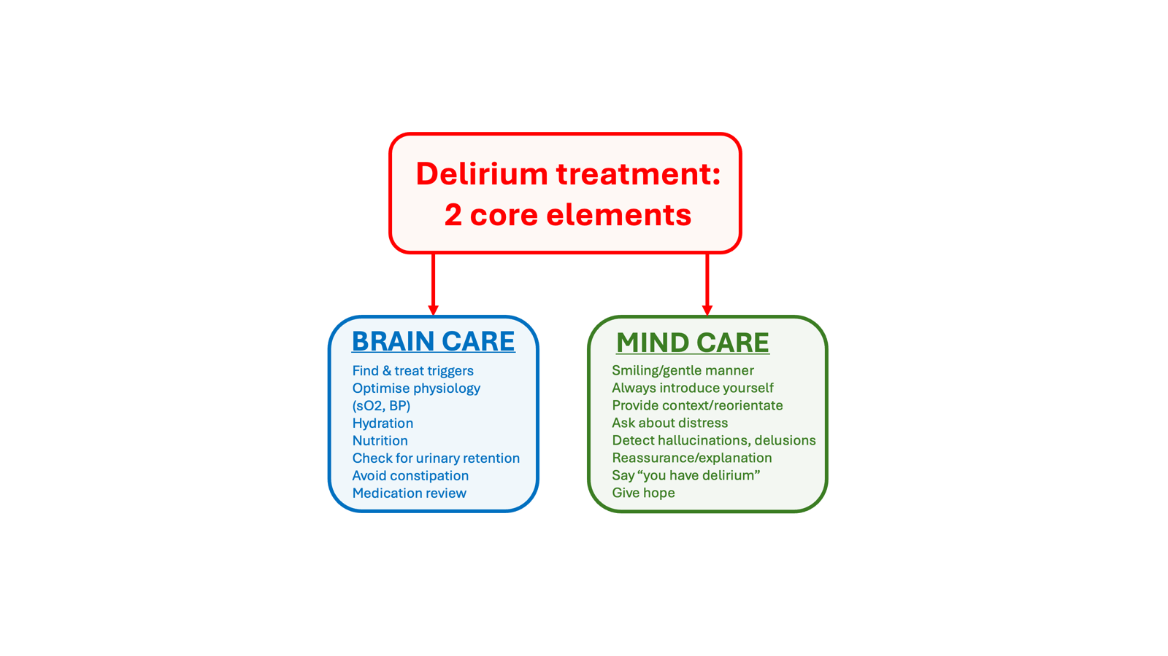
18
Notes:
This illustration from the supplied talks distinguishes physical care from attention to the person’s mental experience. Both are necessary throughout delirium. Brain care includes identifying and treating causes, oxygen and blood-pressure problems, fluids, nutrition, bladder and bowel needs and medicine review. Mind care includes introducing yourself, explaining what is happening, checking distress and unusual experiences, reassurance and continuing human contact. Here sO2 means oxygen saturation and BP means blood pressure. Fluids and food follow the person’s swallowing and fluid plan. The diagram’s two headings organise care; they are not separate teams or sequential stages. Do not promise recovery that the evidence does not support.
Sources
https://deliriumacademy.com/introduction-to-delirium/
Supplied London medical grand-round presentation, slide 43; RCPsych presentation, slide 21; RCPE presentation, slide 41

Slide 19
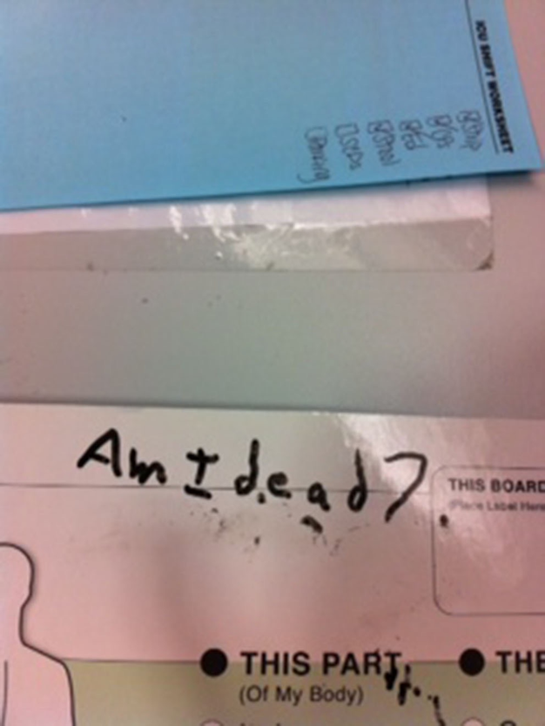
The person’s experience
What does the person
believe is happening?
What explanation
would help now?
Vavuris, Intensive Care Medicine, 2015.
19
Notes:
The photograph and brief question were supplied in the talks, attributed there to Vavuris, Intensive Care Medicine, 2015. Preserve the image and visible wording. Ask learners what a person might need from staff when they feel frightened, uncertain about being alive, or unable to explain what is happening. Do not invent a history for this photograph. The course teaches that ordinary care may feel threatening and that staff should ask how the person feels, explain their actions and allow time to respond. The image is used as a discussion prompt, not as evidence that all patients have this experience.
Sources
https://deliriumacademy.com/introduction-to-delirium/
Supplied RCPsych presentation, slide 2, attributed to Vavuris, Intensive Care Medicine, 2015

Slide 20
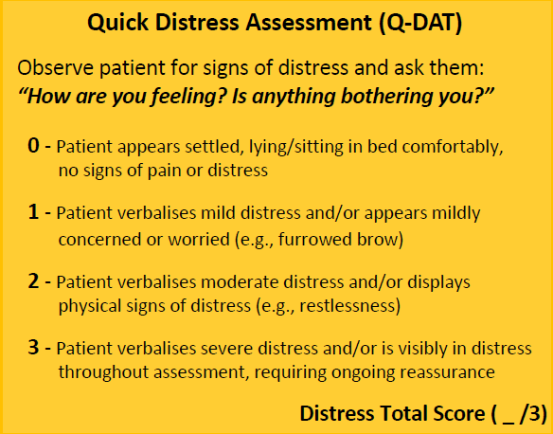
Distress needs its own assessment
Ask.
Observe.
Respond.
McCartney and colleagues, Age and Ageing, 2025. Use according to local arrangements.
20
Notes:
The Quick Distress Assessment shown in the supplied RCPsych talk asks how the person feels and combines the response with observation. It illustrates asking about distress directly rather than inferring it from the 4AT or from visible agitation alone. Use a distress assessment where your service adopts it. Do not present this scale as required by the foundation course or as a replacement for clinical assessment. Check pain and other physical needs, and ask about fear and unusual experiences. A person may be distressed while still and saying little. The source slide attributes this tool to McCartney et al., Age and Ageing, 2025.
Sources
https://deliriumacademy.com/introduction-to-delirium/
Supplied RCPsych presentation, slide 16
https://doi.org/10.1093/ageing/afaf166

Slide 21
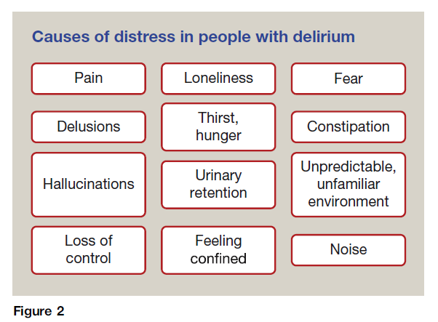
Possible causes of distress
Check physical needs and ask what the person is experiencing.
21
Notes:
Use the supplied illustration to ask which needs should be checked. Pain, bladder and bowel problems, thirst, hunger and uncomfortable positioning may be remediable causes. Fear, loneliness, hallucinations, delusions, loss of control and an unfamiliar environment may also contribute. Assess and treat the person’s actual problems. Reduced movement after sedation does not establish relief of pain or fear. The graphic is retained from medical grand-round slide 46. The source deck attributes related teaching to Wilson et al., Delirium, Nature Reviews Disease Primers, 2020.
Sources
https://deliriumacademy.com/introduction-to-delirium/
Supplied London medical grand-round presentation, slide 46

Slide 22
Speaking with a frightened person
Introduce yourself
Ask how they feel
Explain before touching
Allow time to answer
Example words: “You are in hospital. I’m one of the nurses. I’ll explain what we are doing.”
22
Notes:
Approach within view, at eye level and introduce yourself. Check hearing and communication needs. Speak calmly, explain one thing at a time, then wait for a response. Explain before touching or beginning care. Acknowledge fear without confirming that an imagined threat is real. Avoid arguing, repeated testing of memory, speaking over the person or carrying out procedures without explanation. Involve someone familiar when the person welcomes this. If you promise to return, do so. The words on the slide are examples for teaching, not a quotation from a patient. Persistent distress or immediate risk of harm requires clinical help and the least restrictive safe response under local guidance.
Sources
https://deliriumacademy.com/introduction-to-delirium/
Supplied RCPsych presentation, slides 23–28

Slide 23
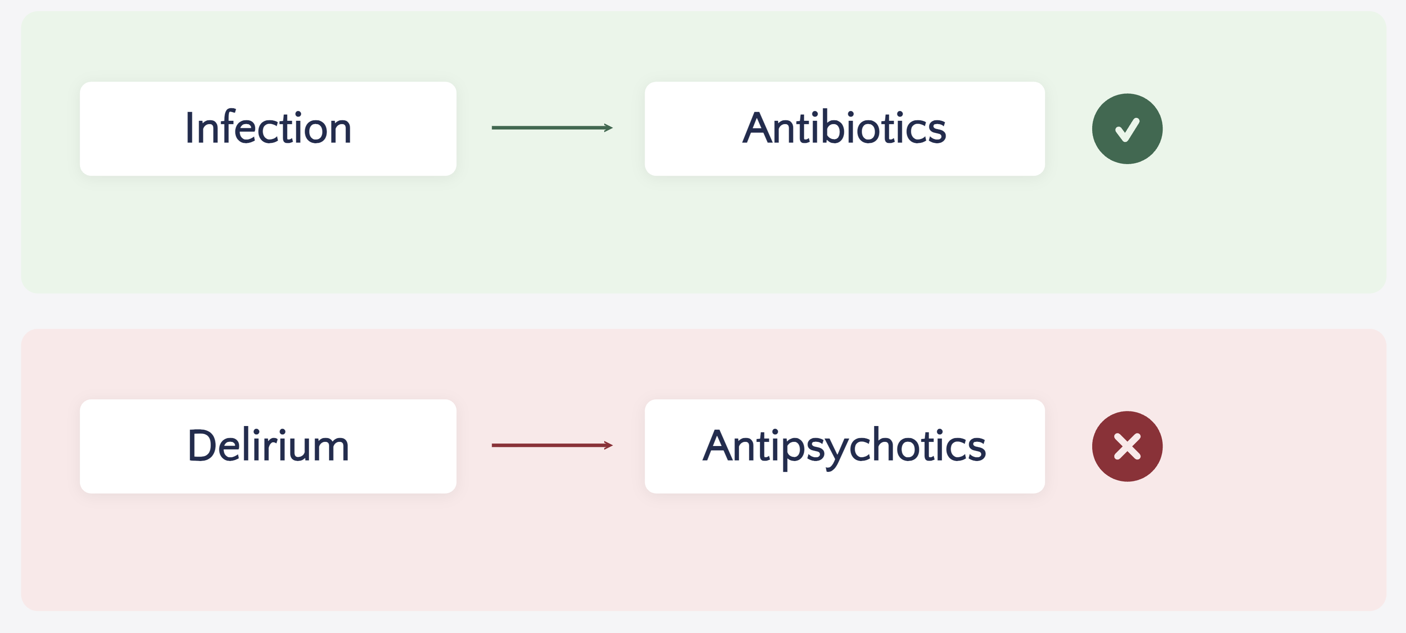
No general drug treatment for delirium
Treat the causes. Continue care and assess distress or immediate safety risks.
23
Notes:
Antipsychotics do not treat delirium itself and should not be prescribed simply because delirium is present. The illustration contrasts treatment of infection with an automatic antipsychotic response to delirium. Treat the identified causes and continue supportive care. Medicine for intractable distress or significant safety risks requires individual prescribing assessment after non-drug measures have been ineffective or inappropriate. Do not interpret this slide as advice to stop a necessary medicine without review. The graphic comes from the supplied London medical talk, slide 51, and RCPE talk, slide 26.
Sources
https://deliriumacademy.com/introduction-to-delirium/
https://www.nice.org.uk/guidance/cg103/chapter/Recommendations
https://www.gov.uk/drug-safety-update/haloperidol-haldol-reminder-of-risks-when-used-in-elderly-patients-for-the-acute-treatment-of-delirium
Supplied London medical grand-round presentation, slide 51

Slide 24
When a medicine is considered
Intractable distress or significant safety risk
after non-drug measures have not helped
An authorised prescriber assesses individual risks
Lowest appropriate dose, shortest possible time
Document monitoring, review and stopping plans
Stop before discharge unless a senior clinician authorises continuation
Haloperidol must not be used in Parkinson’s disease or dementia with Lewy bodies.
24
Notes:
Only an authorised prescriber decides whether a medicine is appropriate. The current course restricts consideration to intractable distress or significant safety risks that have not responded to non-drug measures. Follow current prescribing guidance, account for contraindications and adverse effects, and use the lowest appropriate dose for the shortest possible time. Record the indication, monitoring, review and stopping plans. The course says stop before discharge unless a senior decision maker explicitly authorises continuation. Haloperidol is contraindicated in Parkinson’s disease and dementia with Lewy bodies. Other antipsychotics also need careful consideration in those conditions.
Sources
https://deliriumacademy.com/introduction-to-delirium/
https://www.nice.org.uk/guidance/cg103/chapter/Recommendations
https://www.gov.uk/drug-safety-update/haloperidol-haldol-reminder-of-risks-when-used-in-elderly-patients-for-the-acute-treatment-of-delirium

Slide 25
Several measures together reduce delirium
About 40%
relative reduction
in delirium
Moderate-certainty evidence
Burton and colleagues, Cochrane, 2021. Non-ICU hospital trials.
25
Notes:
The Cochrane review reports 10.5% delirium incidence with multicomponent non-pharmacological prevention compared with 18.4% with usual care. The meta-analytic risk ratio was 0.57, 95% CI 0.46–0.71, across 14 studies and 3,693 participants, with moderate-certainty evidence. The reduction is approximately 40% in relative terms, not 40 percentage points. The raw absolute difference shown is 7.9 percentage points. These are non-ICU hospital trials, not a guarantee for an individual or an effect estimate for a single measure. Do not extrapolate a mortality benefit from this result.
Sources
https://deliriumacademy.com/introduction-to-delirium/
https://doi.org/10.1002/14651858.CD013307.pub2

Slide 26
Everyday care and prevention
Safe movement
Food, fluid and comfort
Glasses and hearing aids
Sleep and familiar contact
Medicine review
Follow the individual swallowing, fluid and mobility plans.
26
Notes:
Start prevention before delirium develops and choose measures for individual needs. Support appropriate movement and rehabilitation with the assistance and equipment the person needs. Help with meals and drinks while following swallowing guidance and any fluid restriction. Provide glasses and working hearing aids. Check pain, bladder and bowel needs. Reduce avoidable night-time interruptions while continuing necessary observations and treatment. Offer familiar contact and avoid unnecessary moves. Ask a clinician or pharmacist to review medicines. No single measure guarantees prevention, and delirium may arise despite appropriate care. If Mrs Morgan is drowsy and has hardly drunk, report the change and check whether oral fluids are safe, rather than forcing a drink.
Sources
https://deliriumacademy.com/introduction-to-delirium/

Slide 27
Recovery can take time
Days or weeks
Sometimes months
Continuing symptoms need review
A new deterioration needs prompt assessment
Explain what to expect, who will review and how to get help.
27
Notes:
Many people improve as causes are treated, but some have symptoms for weeks or months and need continuing support. Recovery may be incomplete. Persistent symptoms need clinical review, reassessment for causes, and a follow-up plan. Offer the person an opportunity to discuss frightening experiences and ongoing problems with thinking, sleep, mobility or everyday activities. Explain the diagnosis, what the team is treating and how to get help. New deterioration requires prompt assessment and emergency help if seriously unwell. Do not label it an expected bad day. Offer Delirium Support resources alongside a conversation and the person’s plan.
Sources
https://deliriumacademy.com/introduction-to-delirium/

Slide 28

Record the word delirium
What changed, and when?
What was found and done?
Who has been informed?
Who reviews next, and when?
At transfer or discharge, include the diagnosis, remaining problems and follow-up.
28
Notes:
Use the clinical term delirium for a confirmed diagnosis. Record the baseline and source of history, the new changes and onset, observations and assessment, who was informed, actions and response, and who reviews next and when. At transfer or discharge, include the diagnosis, course, continuing problems, treatment changes and follow-up. Hand over review and stopping plans for medicines used for distress. Explain the plan to the person and family. The meme is reproduced unchanged from the supplied medical grand-round slide 21, surgical slide 16 and RCPE slide 14. It prompts discussion about terminology, not diagnosis from a photograph.
Sources
https://deliriumacademy.com/introduction-to-delirium/
Supplied London medical grand-round presentation, slide 21

Slide 29
A new change in a care home
Example case
Mr Singh, 88, has missed breakfast.
This is unusual for him.
The carer is unable to hold his attention.
What would you report? Which local route would you use?
Agree the response and check that the concern has been received.
29
Notes:
Example case from course Part 4. Mr Singh, 88, lives in a care home. This morning he missed breakfast, which he never misses, and the carer could not hold his attention. Ask learners to state what they would report and which local route they would use. Answer: the senior carer phones through the home’s urgent medical route, describes the change and onset, and confirms the response. Do not wait for the weekly routine visit. If very difficult to wake, breathing abnormally or otherwise seriously unwell, use the emergency response. If no review happens and the person deteriorates, seek help again urgently. This is a teaching example, not a report of an identifiable resident.
Sources
https://deliriumacademy.com/introduction-to-delirium/

Slide 30
Before you leave the bedside
What is different from usual?
What help is needed now?
How can we help the person feel safer?
Who will review, and when?
Complete the course assessment
deliriumacademy.com/introduction-to-delirium/
30
Notes:
Close with application rather than a second lecture. Ask learners to identify the new change, the help needed now, the care the person needs, and who will review. For course completion, direct them to the online assessment. The current course has 10 questions, requires at least 8 correct and both urgent-action questions, and asks learners to read feedback and correct missed urgent-action answers. A certificate records course completion, not practical competence. The educator should agree local emergency contacts, role boundaries and documentation. Further study is available in the Academy safety, distress, communication, causes and persistent-delirium modules. Families can use Delirium Support.
Sources
https://deliriumacademy.com/introduction-to-delirium/
https://deliriumsupport.com/
https://www.the4at.com/

