Slide 1
Delirium Academy
FOLLOW-ON LEARNING
Safety, distress and agitation
Teaching slides for the follow-on module after Delirium in 30
deliriumacademy.com
01
Notes:
Use alongside the 35-minute online module, version 2.0 (22 September 2026): https://deliriumacademy.com/safety-distress-and-agitation/ . The module has 13 parts. The notes on each slide give the part that teaches it. To play a scene or animation in the session, open that part: add #s and the part number to the address, for example https://deliriumacademy.com/safety-distress-and-agitation/#s2 for the first minute. This deck supports discussion and local rehearsal. Practical emergency response, restraint and drug administration require the appropriate local training. Allow additional time for discussion and policy familiarisation.
Teaching resource, September 2026. Adapt local contacts and responsibilities. Preserve clinical qualifications and source links.

Slide 2
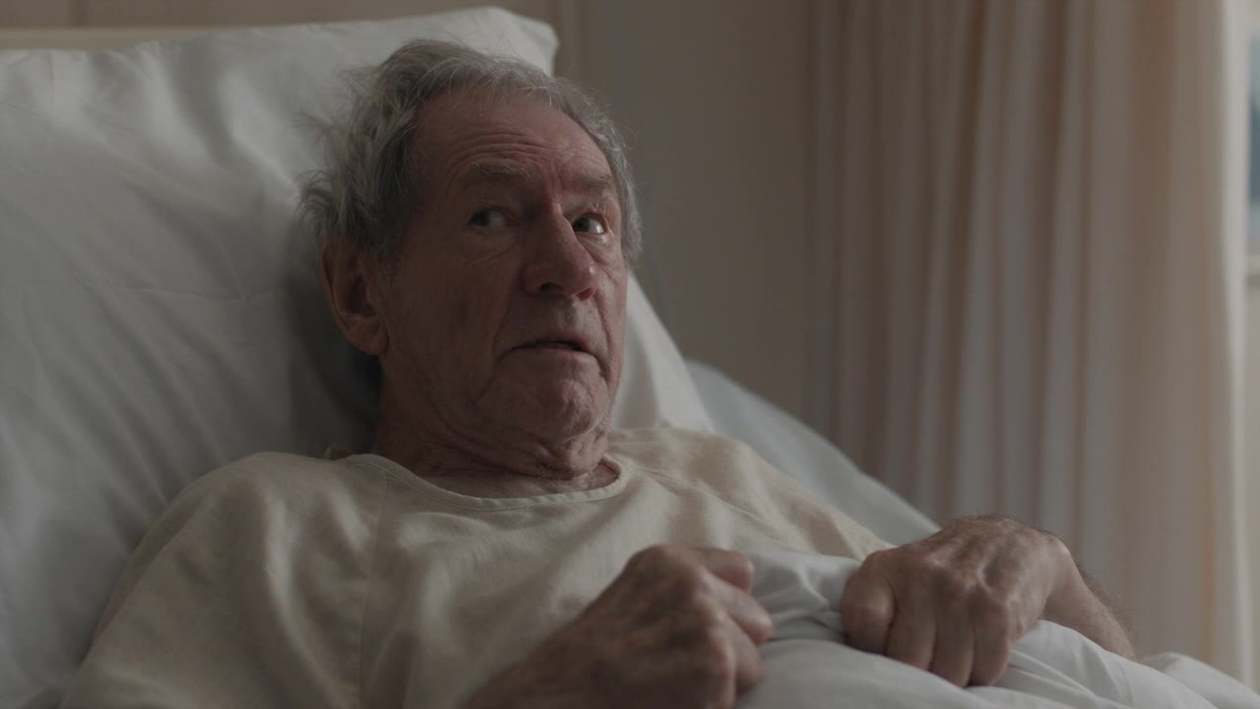
Delirium Academy
FOLLOW-ON LEARNING
Mr Lee believes staff are holding him prisoner
He pushes a nurse’s hand away from his oxygen and tries to climb over the bed rail.
His daughter is frightened. Another patient is within reach.
What are the dangers now, and who else is at risk?
AI-generated teaching scene · Part 1
deliriumacademy.com
02
Notes:
Example case, Part 1: https://deliriumacademy.com/safety-distress-and-agitation/#s1 . Mr Lee, 72, was admitted with pneumonia. Since this morning he has struggled to follow conversation. Play the 30-second scene of a frightened man who wants to leave. The nurse is out of shot: she gives her name, says she will not touch him, asks what frightens him and whether he is in pain, and steps back when he says “Keep back.” Ask what she could check from where she stands: is he about to climb out of bed, is a drip or tube pulled tight, and who else does she need? The team needs clinical assessment of causes alongside help with safety.
Teaching resource, September 2026. Adapt local contacts and responsibilities. Preserve clinical qualifications and source links.

Slide 3
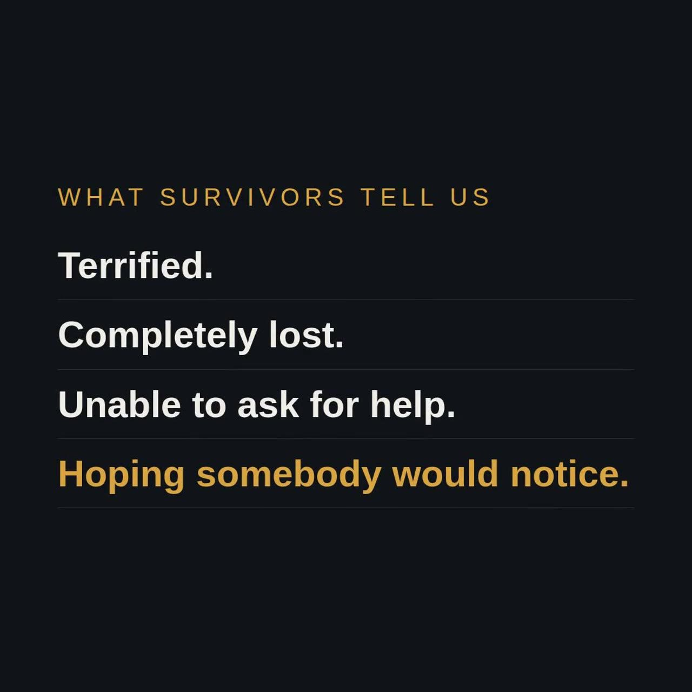
Delirium Academy
FOLLOW-ON LEARNING
Two kinds of danger
Agitated delirium: falls, pulled out drips and tubes, injury to staff and others, leaving.
Drowsy delirium: pressure ulcers, choking, dehydration, and pain or deterioration that nobody notices.
Many people move between the two during the same illness.
Animation · Part 6
deliriumacademy.com
03
Notes:
Parts 1 and 6: https://deliriumacademy.com/safety-distress-and-agitation/#s1 and https://deliriumacademy.com/safety-distress-and-agitation/#s6 . Agitation draws attention. A person who is drowsy and withdrawn can come to serious harm unnoticed. Harm from sedation or restraint also belongs on the agitated side. Plan care around what the person can do now, and review it through the day. The animation shows what the ward sees in a drowsy person (quiet, “no bother”) beside what survivors describe (terrified, lost, unable to ask for help).
Teaching resource, September 2026. Adapt local contacts and responsibilities. Preserve clinical qualifications and source links.

Slide 4
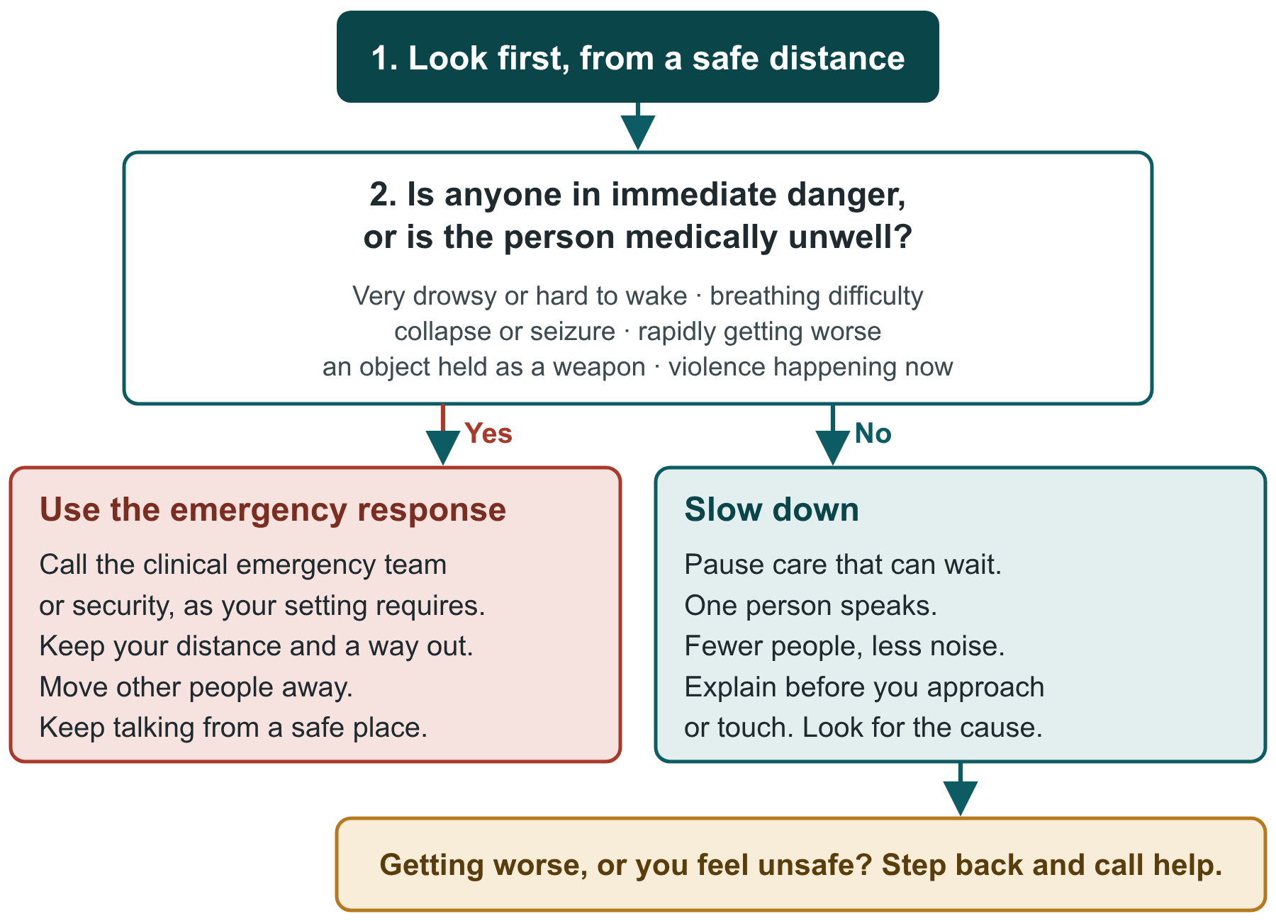
Delirium Academy
FOLLOW-ON LEARNING
The first minute
Look first, from a safe distance.
Immediate danger or medically unwell: use the emergency response.
Otherwise slow down. Step back and call help if things get worse.
deliriumacademy.com
04
Notes:
Part 2: https://deliriumacademy.com/safety-distress-and-agitation/#s2 . Immediate danger or medical illness includes: very drowsy or hard to wake, breathing difficulty, collapse or seizure, rapidly getting worse, an object held as a weapon, or violence happening now. A delirium score or a conversation must never delay emergency treatment. Low oxygen, low blood glucose, sepsis, stroke, seizures, a head injury after a fall, alcohol withdrawal and severe pain can all show as sudden agitation or drowsiness. When you call for help, give your location, what is happening, how unwell the person is and what help you need. Slowing down means: pause care that can wait, one person speaks, fewer people and less noise, explain before you approach or touch, and look for the cause.
Teaching resource, September 2026. Adapt local contacts and responsibilities. Preserve clinical qualifications and source links.

Slide 5
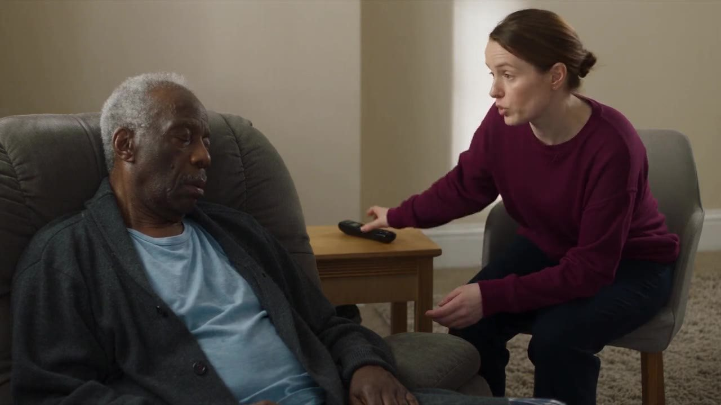
Delirium Academy
FOLLOW-ON LEARNING
When it is a medical emergency
Stop asking questions and use the emergency response.
Keep your distance and a way out. Move other people away.
Keep talking from a safe place until help arrives.
AI-generated teaching scene · Part 2
deliriumacademy.com
05
Notes:
Part 2: https://deliriumacademy.com/safety-distress-and-agitation/#s2 . In the 30-second scene, a carer at home stops asking questions and acts. On a ward the same rule applies: stop the conversation and use the emergency response. Practice question from the module: a man is standing by his bed with a walking stick raised above his head, shouting. Two other patients are in the bay. Best answer: step back, move others away if safe, and call security or trained help. Keep talking from a safe distance; do not try to take the stick.
Teaching resource, September 2026. Adapt local contacts and responsibilities. Preserve clinical qualifications and source links.

Slide 6
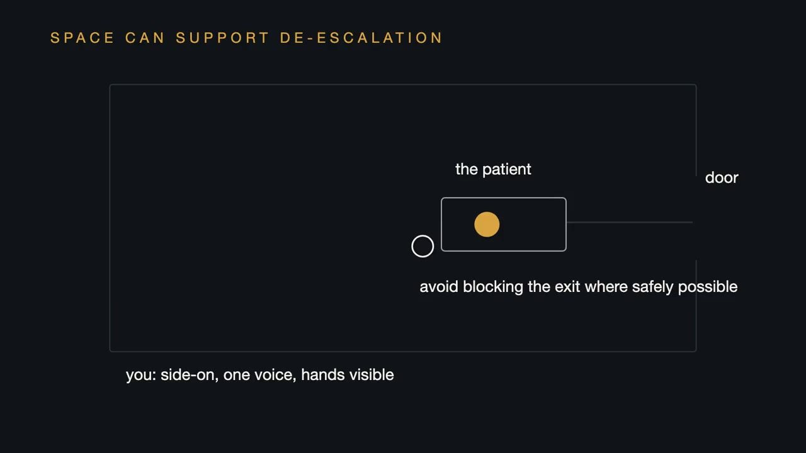
Delirium Academy
FOLLOW-ON LEARNING
Use space
Stand at an angle, with your hands visible and open.
Stay out of reach. Keep your own way out clear, and avoid blocking theirs.
Never ask relatives or other patients to hold, lift or restrain someone.
Animation · Part 2
deliriumacademy.com
06
Notes:
Part 2: https://deliriumacademy.com/safety-distress-and-agitation/#s2 . Do not approach from behind and do not corner the person. Where it is safe, move things that could be thrown or used to hit. Family members and other patients should never be asked to hold, lift or restrain someone. Ask them to step back, and involve them in calming the person only when it is safe.
Teaching resource, September 2026. Adapt local contacts and responsibilities. Preserve clinical qualifications and source links.

Slide 7
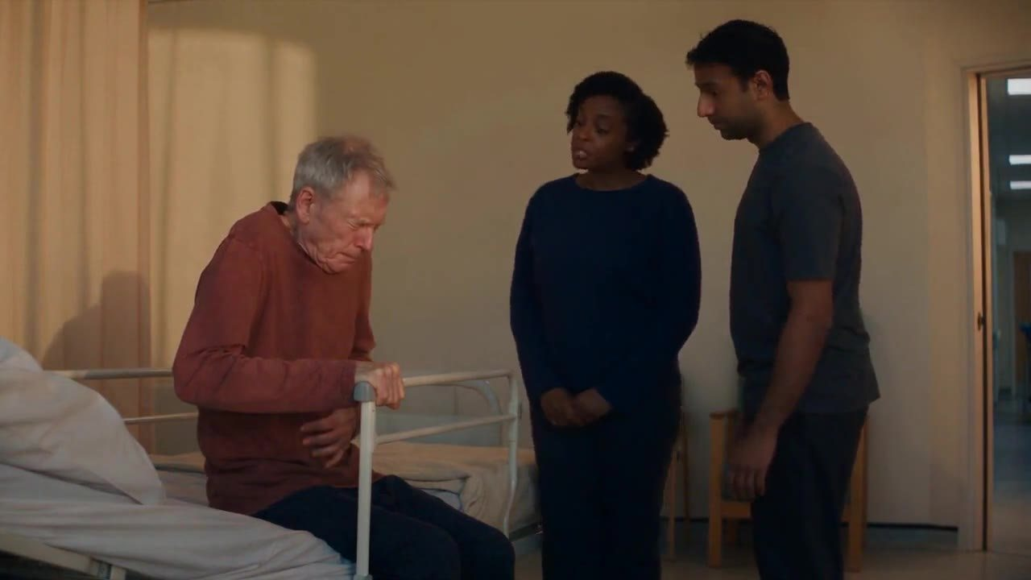
Delirium Academy
FOLLOW-ON LEARNING
Look for the cause
Pain, a full bladder or blocked catheter, constipation.
Thirst, needing the toilet, low oxygen or low blood glucose, withdrawal.
Fear, new medicines, noise, and missing glasses or hearing aids.
AI-generated teaching scene · Part 3
deliriumacademy.com
07
Notes:
Part 3: https://deliriumacademy.com/safety-distress-and-agitation/#s3 . Agitation and distress usually have causes, and some can be found and treated within minutes. Check the common ones every time, and ask a clinician to look for the medical causes of the delirium itself. The 54-second scene shows two simple questions finding the cause. Practice question: a man has become more restless over two hours, keeps trying to stand and is pulling at his catheter. Check first whether the catheter is blocked, his bladder is full or he is in pain. Confusion alone is not evidence of infection. For a fuller approach, see https://deliriumacademy.com/identifying-triggers-of-delirium/ .
Teaching resource, September 2026. Adapt local contacts and responsibilities. Preserve clinical qualifications and source links.

Slide 8
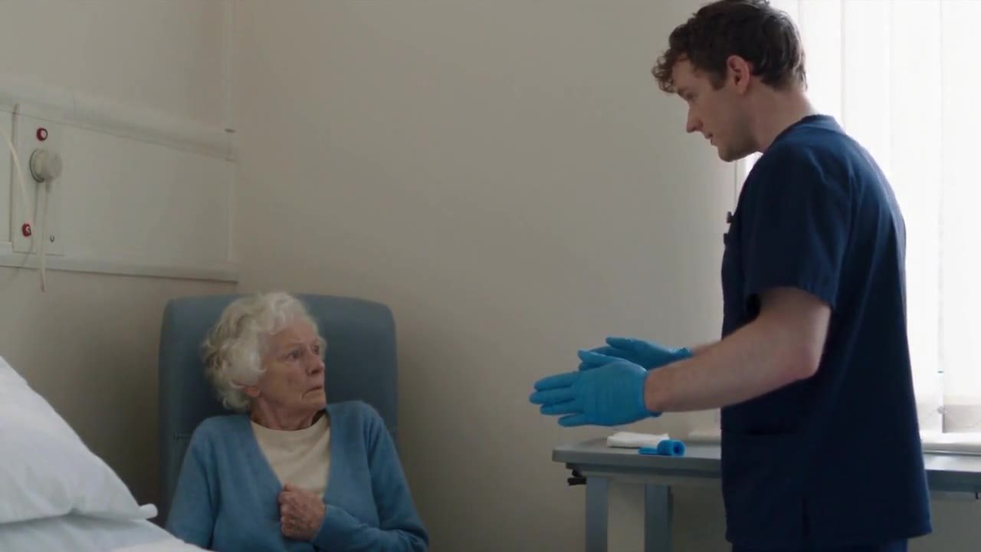
Delirium Academy
FOLLOW-ON LEARNING
Therapeutic engagement: two stages
1. Find out how the person is feeling, before you act.
2. Respond with information, reassurance and company.
Explain before every procedure, however small. Stop if the person says no, unless it is an emergency.
AI-generated teaching scene · Part 4
deliriumacademy.com
08
Notes:
Part 4: https://deliriumacademy.com/safety-distress-and-agitation/#s4 . Stage 1: learn about the person from family and records; look from the end of the bed for a few seconds before speaking; introduce yourself and use the preferred name; ask “How are you feeling?”; if conversation is hard, ask simple yes or no questions. Stage 2: explain where they are, why they are here and what is happening now, and repeat it without testing them; reassure truthfully; talk about familiar things; offer company, something to do and a chance to move; involve family and staff the person knows. Stage 1 often finds the cause. In the 44-second scene, the staff member starts without explaining, then puts it right. People who remember delirium in intensive care describe fear, anger and shame, and valued staff who were kind, explained what was happening and stayed (Boehm and colleagues, 2021: https://doi.org/10.1016/j.ijnurstu.2021.104030).
Teaching resource, September 2026. Adapt local contacts and responsibilities. Preserve clinical qualifications and source links.

Slide 9
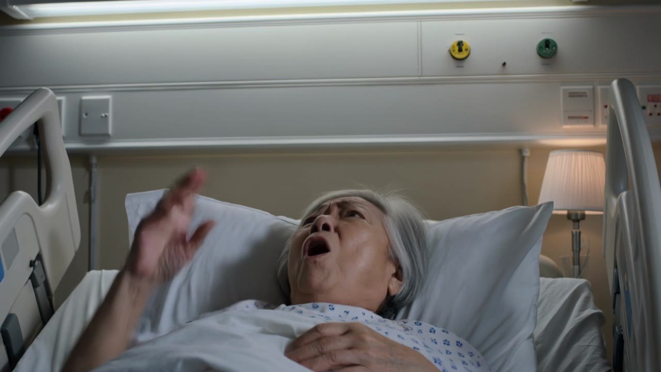
Delirium Academy
FOLLOW-ON LEARNING
Words that help
“That sounds frightening. Tell me what’s worrying you about the drink.”
“I can’t see them, but I can see they’re frightening you. You’re safe.”
“You want to get home. Who’s there waiting for you? Walk with me.”
AI-generated teaching scene · Part 5
deliriumacademy.com
09
Notes:
Part 5: https://deliriumacademy.com/safety-distress-and-agitation/#s5 . One person speaks. Use short sentences, one idea at a time, and wait for an answer. Name the feeling. You do not need to agree with a false belief, and arguing tends to make it stronger. Offer small, safe choices. Keep your voice low and slow. Say only what is true: for “Where’s my daughter?”, say she is coming back only if that is true, and if you do not know, say you will find out. If the person is abusive, do not argue or defend yourself; if it continues, step away and ask a colleague to try. Delirium does not by itself mean that a person lacks capacity: capacity is about a specific decision at a specific time.
Teaching resource, September 2026. Adapt local contacts and responsibilities. Preserve clinical qualifications and source links.

Slide 10
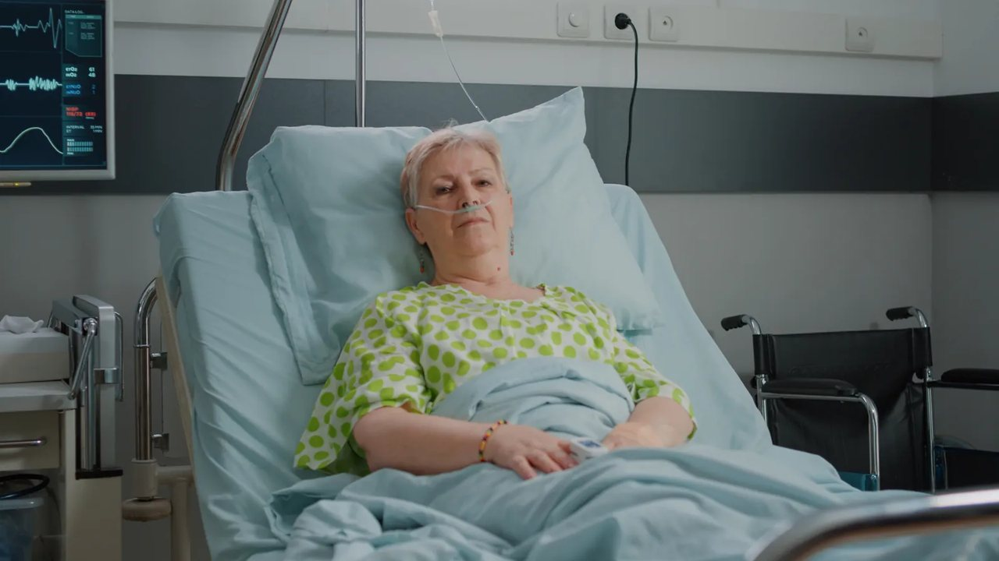
Delirium Academy
FOLLOW-ON LEARNING
Falls, pressure ulcers and other harms
Falls: low bed, call bell, glasses, walking aid and a drink within reach.
Pressure ulcers: follow the repositioning plan and report red or broken skin the same day.
Swallowing: sit the person up and check alertness. Hold food, drink and tablets if unsafe.
Photograph for illustration · Part 6
deliriumacademy.com
10
Notes:
Part 6: https://deliriumacademy.com/safety-distress-and-agitation/#s6 . Bed rails can lead to climbing and entrapment and need their own assessment. After a fall, check for injury before moving the person and follow your post-fall procedure. A head injury in someone taking anticoagulants (blood thinners) needs urgent medical review. Stop oral intake if the person coughs, splutters or develops a wet, gurgling voice, and ask for a swallowing assessment and a plan for fluids, nutrition and essential medicines. Offer drinks often and record intake. Ask every day which drips, tubes and devices are still needed. Know your local procedure for a person missing from the ward or home. Close observation works best when the observer engages with the person. If the agreed observation or staffing is not available, tell the nurse in charge, record it and agree an interim plan. A relative may help, but a relative does not replace staffing. Practice question: Mrs Adeyemi, 84, has lain still since the morning handover and is “no bother”. Check her now.
Teaching resource, September 2026. Adapt local contacts and responsibilities. Preserve clinical qualifications and source links.

Slide 11
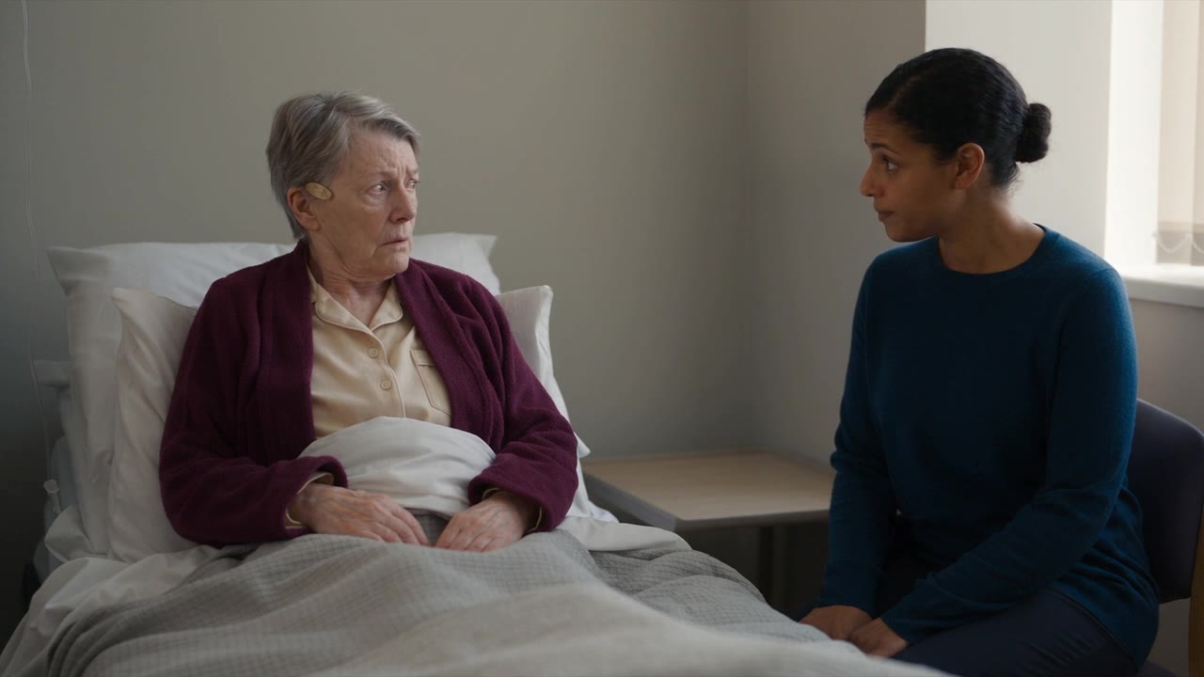
Delirium Academy
FOLLOW-ON LEARNING
Essential treatment and restraint
Is it essential now, or could it be given another way or at another time?
Try engagement first, and involve a senior clinician early.
Restraint only to prevent serious harm: shortest time, trained staff, monitoring, review.
AI-generated teaching scene · Part 7
deliriumacademy.com
11
Notes:
Part 7: https://deliriumacademy.com/safety-distress-and-agitation/#s7 . In the 30-second scene the check can wait, so when Mrs Evans is unsure the nurse stops and offers to explain again or come back later. If a treatment is essential now, such as oxygen when oxygen levels are low, holding a mask on against resistance can add to fear. Alternatives: nasal oxygen if needs allow; explaining and giving time; a familiar person; treating pain and other causes; and a senior decision on what is needed and how to give it. If treatment has to be given without agreement, follow the law and local procedure, use the least restrictive approach and record what was done, why, and who decided. Restraint means any action that restricts movement or behaviour: holding a person, mittens, bed rails used to stop someone getting out, tilted chairs, a table fixed in front of a chair, and medicines given to control behaviour. Never use it as punishment or for convenience. Never restrain anyone in a way that affects breathing or circulation, for example by pressing on the chest, neck or abdomen. Avoid taking a person to the floor; if it happens, keep them face up where possible (NICE NG10: https://www.nice.org.uk/guidance/ng10/chapter/recommendations). Practice question: a colleague suggests mittens for a man who keeps pulling out his cannula. Ask a senior clinician about tablets or another route, and cover the site. No restraint technique is taught here.
Teaching resource, September 2026. Adapt local contacts and responsibilities. Preserve clinical qualifications and source links.

Slide 12

Delirium Academy
FOLLOW-ON LEARNING
Your safety and your team’s
Agree three roles: one person speaks, one coordinates, one supports.
Racist, sexual or abusive behaviour: stop, step back, say it is not acceptable, report it.
If you are hurt: get checked, report it, take a break and ask for a debrief.
Photograph for illustration · Part 8
deliriumacademy.com
12
Notes:
Part 8: https://deliriumacademy.com/safety-distress-and-agitation/#s8 . Know how to call for help before you need it. Keep personal space and a way out. Follow lone working arrangements in care homes and people’s own homes. The coordinator assesses the clinical situation, directs the team and decides what happens next; the support role calls for help, moves others away and fetches what is needed. Trained security staff can help with immediate safety; the clinical team stays responsible for assessment and treatment. Report abusive behaviour even when illness is the cause, so that the team can plan care (for example two staff for personal care) and support you. Record in specific words: “Hit a staff member on the arm when the catheter was touched” tells the next team more than “aggressive”. Being hurt is not a sign that you did something wrong.
Teaching resource, September 2026. Adapt local contacts and responsibilities. Preserve clinical qualifications and source links.

Slide 13
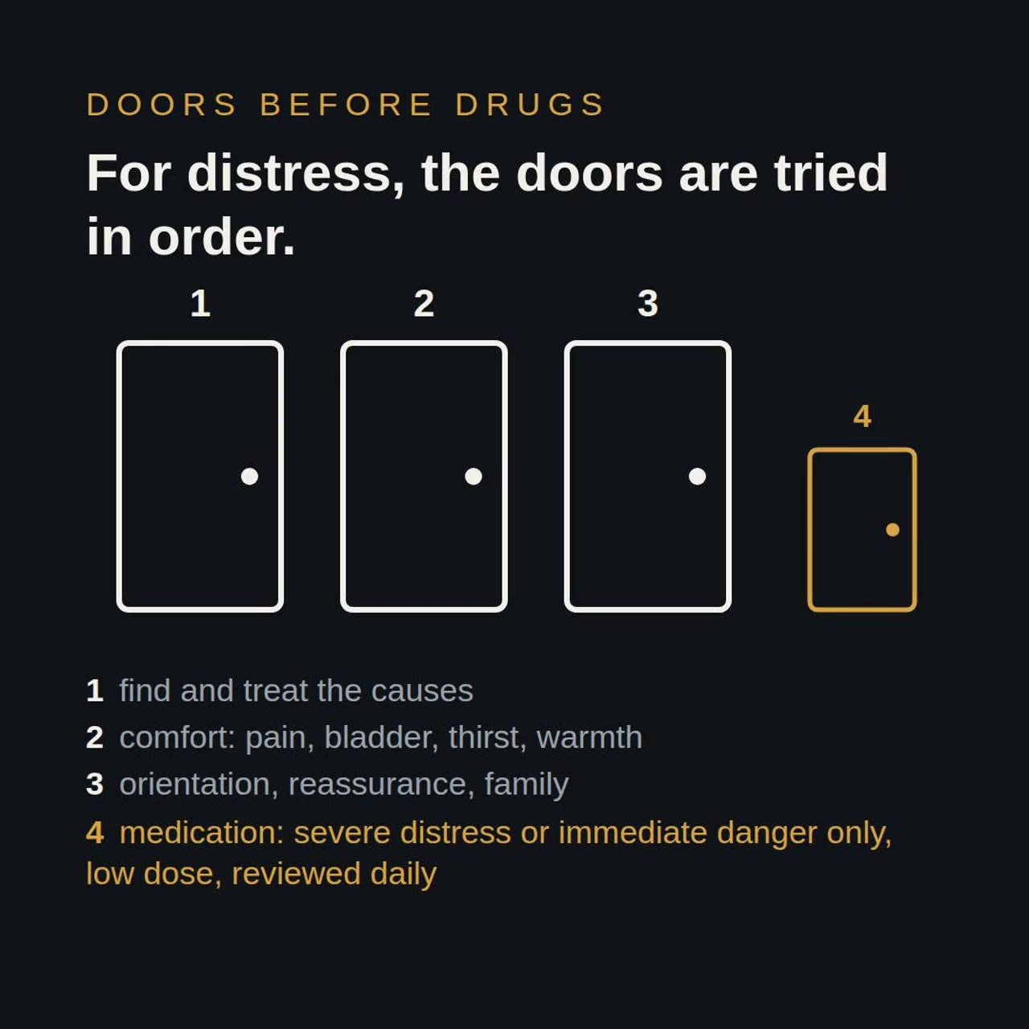
Delirium Academy
FOLLOW-ON LEARNING
Medicines: last and limited
A medicine only when all three apply: significant distress or risk, causes treated, other approaches failed.
Haloperidol must not be used in Parkinson’s disease or dementia with Lewy bodies.
After a medicine: check breathing and how easily the person wakes.
Animation · Part 9
deliriumacademy.com
13
Notes:
Part 9: https://deliriumacademy.com/safety-distress-and-agitation/#s9 . Antipsychotics have not been shown to shorten delirium or hospital stay or to reduce deaths (Nikooie and colleagues, 2019: https://doi.org/10.7326/M19-1860), and they are not recommended to prevent delirium or to speed recovery. An authorised prescriber makes and records the decision, including the target symptom, the dose and when it will be reviewed. Before haloperidol, the MHRA advises a baseline ECG and correction of electrolyte problems: https://www.gov.uk/drug-safety-update/haloperidol-haldol-reminder-of-risks-when-used-in-elderly-patients-for-the-acute-treatment-of-delirium . Other antipsychotics also need specialist judgement in Parkinson’s disease and dementia with Lewy bodies. Benzodiazepines are generally avoided unless there is a specific reason, such as alcohol or benzodiazepine withdrawal. Becoming still does not prove that distress or the illness has improved. Excessive sleepiness, breathing problems, stiffness, restlessness or new difficulty swallowing need prompt review. In the last days of life, relieving distress becomes the main aim: look for pain, a full bladder or constipation first, then follow palliative care guidance. The course gives no doses or rapid tranquillisation regimens. Practice question: at 1 a.m. a colleague says “Just give him something to knock him out.” Ask what it is for, what has been tried and what might be causing it.
Teaching resource, September 2026. Adapt local contacts and responsibilities. Preserve clinical qualifications and source links.

Slide 14
Delirium Academy
FOLLOW-ON LEARNING
Intensive care
A threat to the airway or an essential device needs the bedside ICU team now.
Three separate questions: pain (CPOT or BPS), agitation and sedation (RASS or SAS), delirium (CAM-ICU or ICDSC).
RASS is not a delirium assessment and does not give a 4AT result.
deliriumacademy.com
14
Notes:
Part 10: https://deliriumacademy.com/safety-distress-and-agitation/#s10 . Ms Mensah, 56, is receiving mechanical ventilation. As her sedation is reduced, she looks frightened and reaches for the tube. Agitation during a change in sedation is not enough, on its own, to diagnose delirium. Restraint does not reliably prevent a person removing a tube and can increase agitation; the ICU team weighs the alternatives. Use one speaker and short explanations; agree a way to communicate, such as nods, hand squeezes or a letter or picture board. Deep sedation or unresponsiveness can prevent a valid delirium assessment. The 2025 SCCM PADIS focused update found insufficient evidence to recommend for or against antipsychotics for treating delirium in intensive care (https://doi.org/10.1097/CCM.0000000000006574). Sedation choices and emergency drug regimens belong to the ICU team and its protocols.
Teaching resource, September 2026. Adapt local contacts and responsibilities. Preserve clinical qualifications and source links.

Slide 15
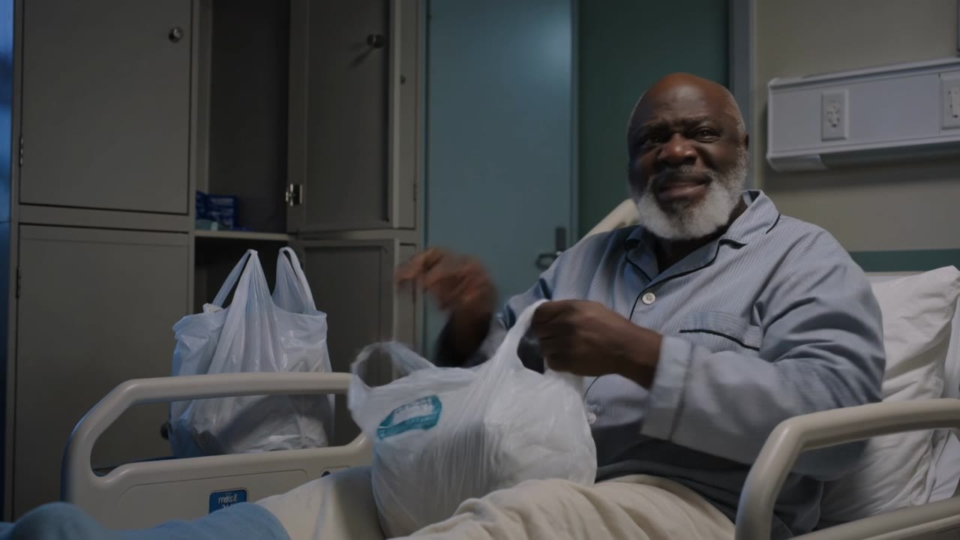
Delirium Academy
FOLLOW-ON LEARNING
Hard calls: what would you do?
2 a.m. Samuel is dressed, holding his bags and walking towards the exit. Two nurses, 28 patients.
His daughter: “Can’t you give him something to calm him down?”
Mrs Chen needs close observation, and nobody is free to stay with her.
AI-generated teaching scene · Part 11
deliriumacademy.com
15
Notes:
Part 11: https://deliriumacademy.com/safety-distress-and-agitation/#s11 . Ask the group before giving the module’s answers. 1. Walk with him, talk about home, and call the nurse in charge for help. Whether he can be stopped from leaving depends on his capacity and the law where you work; the nurse in charge and a senior clinician decide. If he leaves, follow the missing person procedure at once. 2. Acknowledge how upsetting this is, explain delirium and why medicines come last, and involve her: a familiar voice often helps. Pass the request on; a clinician decides, and medicines are sometimes needed. 3. Tell the nurse in charge, record the gap and agree an interim plan. Restraint and handing responsibility to family are unsafe substitutes.
Teaching resource, September 2026. Adapt local contacts and responsibilities. Preserve clinical qualifications and source links.

Slide 16
Delirium Academy
FOLLOW-ON LEARNING
Three more hard calls
A patient punched you an hour ago. You are due to help wash him again.
A man with delirium says that a member of staff hit him last night.
Mr Brown is in the last days of life. He is restless and moaning.
deliriumacademy.com
16
Notes:
Part 11: https://deliriumacademy.com/safety-distress-and-agitation/#s11 . 1. Tell the nurse in charge, get checked, report it and ask for cover. You are entitled to care and support after an injury; talk it through at a debrief. 2. Listen, record his words, check for injury and report it to safeguarding. Delirium does not make a report untrue. Do not find the staff member and question them yourself. 3. Check for pain, a full bladder or constipation, and ask for palliative advice. Palliative care guidance includes medicines for agitation. Part 8 adds a further scenario on sexual behaviour towards a healthcare assistant during washing.
Teaching resource, September 2026. Adapt local contacts and responsibilities. Preserve clinical qualifications and source links.

Slide 17
Delirium Academy
FOLLOW-ON LEARNING
After the episode
Reassess: injury, causes, devices, observation, and the effects of any medicine or restraint.
Talk with the person when they are able. Never ask anyone to apologise for symptoms of illness.
Debrief: what happened before, what helped, what made it worse, and what the team will change.
deliriumacademy.com
17
Notes:
Part 12: https://deliriumacademy.com/safety-distress-and-agitation/#s12 . Many people remember delirium, often as frightening. Listen without assuming their memories are wrong, and explain what happened. Avoid blame. Offer the family information and a chance to ask questions. Report the incident under local policy and support the staff involved.
Teaching resource, September 2026. Adapt local contacts and responsibilities. Preserve clinical qualifications and source links.

Slide 18
Delirium Academy
FOLLOW-ON LEARNING
A useful handover
What changed, when, and what may be causing it.
What the person is experiencing, and what helps.
Risks now, medicines given and their effects, and who will review when.
deliriumacademy.com
18
Notes:
Part 12: https://deliriumacademy.com/safety-distress-and-agitation/#s12 . Example: “Mr Lee became frightened and agitated at 14:00 and tried to climb over the bed rail. He thought the oxygen tubing was holding him down. Pain and low oxygen were treated, and he is calmer with his daughter present and one person speaking. He is at risk of falls and of pulling off his oxygen. No medicines were given. Dr Lee will review him at 18:00.” Ask learners to practise aloud using only the information in the case. Compare “Aggressive and uncooperative overnight”: labels such as aggressive describe character rather than events. Agree local emergency numbers, the person responsible for senior review, access to interpreters and communication aids, extra staff for observation, and support after an incident.
Teaching resource, September 2026. Adapt local contacts and responsibilities. Preserve clinical qualifications and source links.

Slide 19
Delirium Academy
FOLLOW-ON LEARNING
Assessment and local practice
Ten questions: at least 8 correct, including all five safety questions.
Safety questions: emergency response, stepping back, swallowing, haloperidol, sleepiness after a medicine.
Arrange supervised practice for clinical skills.
deliriumacademy.com
19
Notes:
The online requirement also includes confirmation that the learner has read the answer feedback. Wrong answers show the best answer and link back to the part that teaches it. The certificate records course completion, not identity, accreditation or clinical competence. Use your existing process for recording completion and assessing practical skills. Practical restraint techniques and emergency medication require separate approved training.
Teaching resource, September 2026. Adapt local contacts and responsibilities. Preserve clinical qualifications and source links.

